Slide 1


Upper Coastal Plain Rural Planning Organization (UCPRPO)
TCC Meeting
January 4, 2022
Edgecombe County - Johnston County – Nash County – Wilson County
The meeting will begin at 2:00 PM
Please mute your line if you have not already done so.

Slide 2
UCPRPO TCC Meeting
Edgecombe County - Johnston County – Nash County – Wilson County
January 4, 2022
Meeting Guidelines
Please keep your microphone on mute until you are ready to make a comment or ask a questions.
Turn your microphone on to speak but remember to turn it off once you have finished.
Begin with stating your name so everyone will know who is speaking.
You may use the chat feature to send a note. The chat will be checked, but please get my attention if I fail to respond quickly.
All votes will be completed by roll call as per NCGS 166A-19.24(b)(5). When the chair calls for a vote, I will call roll and ask each person to respond with a ‘yes’ or ‘no’.
Please remember to mute yourself again after roll call.
Please keep microphone muted
Chat is enabled

Slide 3
UCPRPO TCC Meeting
Edgecombe County - Johnston County – Nash County – Wilson County
January 4, 2022
1. Welcome & Introductions – James Diggs – TCC Chair
ROLL CALL
2. REVIEW AGENDA FOR ADDITIONS OR CORRECTIONS

Slide 4
UCPRPO TCC Meeting
Edgecombe County - Johnston County – Nash County – Wilson County
January 4, 2022
3. APPROVAL OF UCPRPO TCC MEETING MINUTES
Review and approval of the September 13, 2021 minutes with a motion and second….. Then roll call

Slide 5
UCPRPO TCC Meeting
Edgecombe County - Johnston County – Nash County – Wilson County
January 4, 2022
4. Member updates from members around the Region
Roll call will be completed to allow each member an opportunity to provide updates from each member jurisdiction.
EDGECOMBE
JOHNSTON
NASH
WILSON

Slide 6
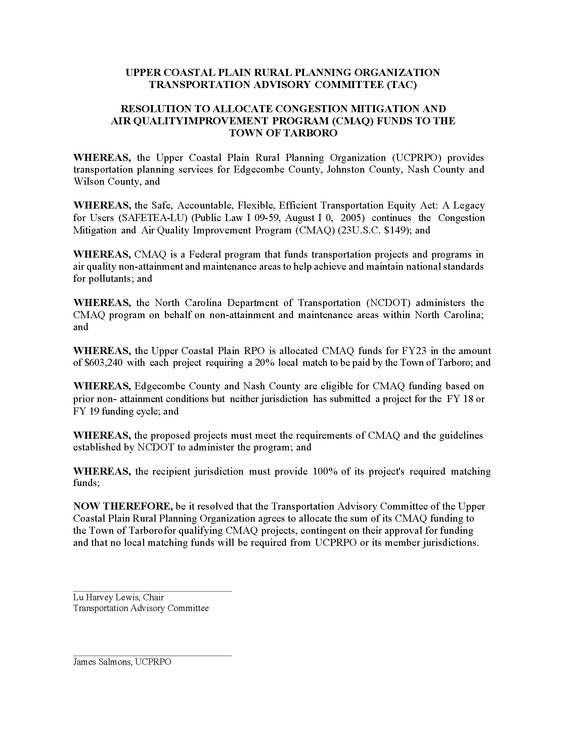
UCPRPO TCC Meeting
Edgecombe County - Johnston County – Nash County – Wilson County
January 4, 2022
5. Resolution of Support for Town of Tarboro CMAQ Application
The UCPRPO has $603,240 to allocate for CMAQ projects for FY2023.
CMAQ = Congestion Mitigation & Air Quality
Funds require a 20% match and must be managed or administered by funding recipient. Program is a reimbursement program not a grant.
Looking for a motion and second…….
To recommend the Town of Tarboro’s CMAQ application to the TAC
Roll Call

Slide 7
UCPRPO TCC Meeting
Edgecombe County - Johnston County – Nash County – Wilson County
January 4, 2022
Decision Item
6. Election of UCPRPO TCC Chair and Vice Chair
The Bylaws state that the TCC will consist of Chairman and Vice-Chairman serving annual terms, but limited to two (2) consecutive terms.
Current Chair: James Diggs, Wilson County
Vice-Chair: Adam Tyson, Nash County
Asking members for nominations……
Motion to elect members to Chair and Vice-Chair…..
Roll Call….........

Slide 8
UCPRPO TCC Meeting
Edgecombe County - Johnston County – Nash County – Wilson County
January 4, 2022
7. Prioritization P6 Update – STI Project Scores Released
The NCDOT SPOT Office released the STI P6 Project Scores on November 12, 2001.
Ultimately over 2,300 projects over all six modes were scored! As a reminder, with the remainder of the P6 process being halted, no local input points will be assigned, and this quantitative score release concludes the P6 Prioritization cycle.
Note that Statewide Mobility scores will be out of 100, Regional Impact scores will be out of 70, and Division Needs scores will be out of 50.

Slide 9
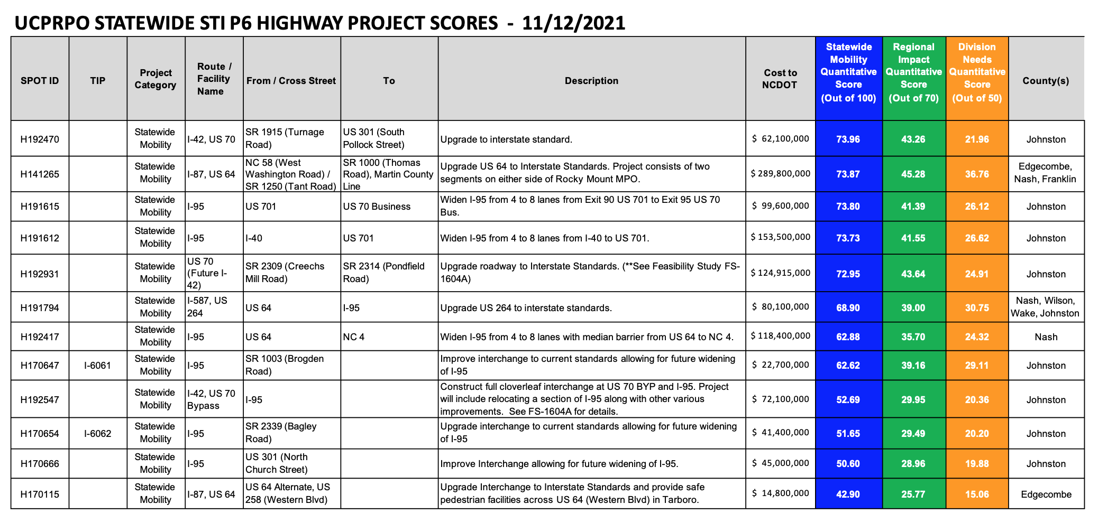
UCPRPO TCC Meeting
Edgecombe County - Johnston County – Nash County – Wilson County
January 4, 2022
7. Prioritization P6 Update – STI Project Scores Released

Slide 10
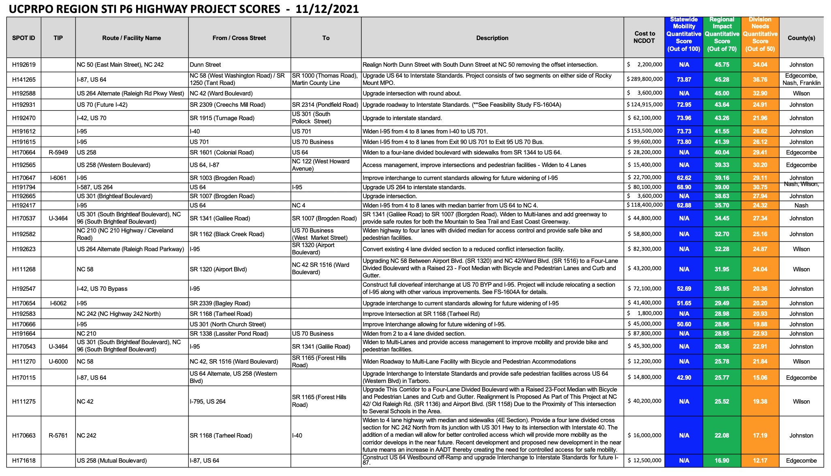
UCPRPO TCC Meeting
Edgecombe County - Johnston County – Nash County – Wilson County
January 4, 2022
7. Prioritization P6 Update – STI Project Scores Released

Slide 11
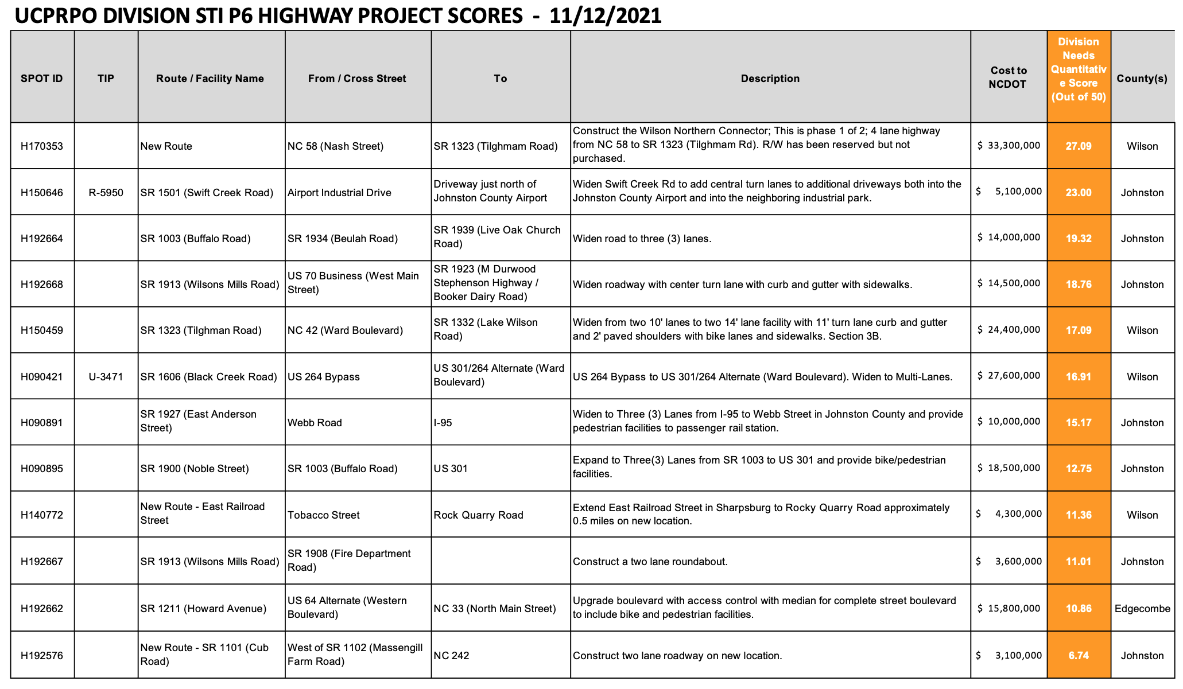
UCPRPO TCC Meeting
Edgecombe County - Johnston County – Nash County – Wilson County
January 4, 2022
7. Prioritization P6 Update – STI Project Scores Released

Slide 12
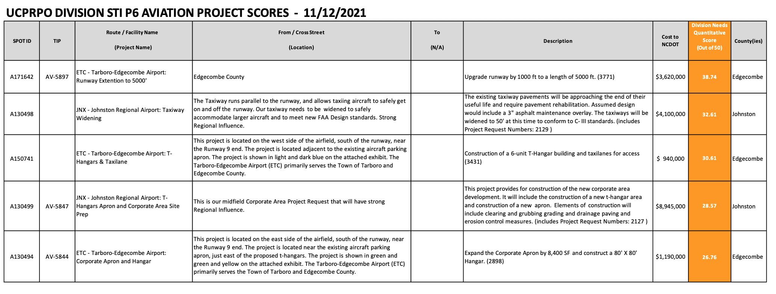
UCPRPO TCC Meeting
Edgecombe County - Johnston County – Nash County – Wilson County
January 4, 2022
7. Prioritization P6 Update – STI Project Scores Released

Slide 13
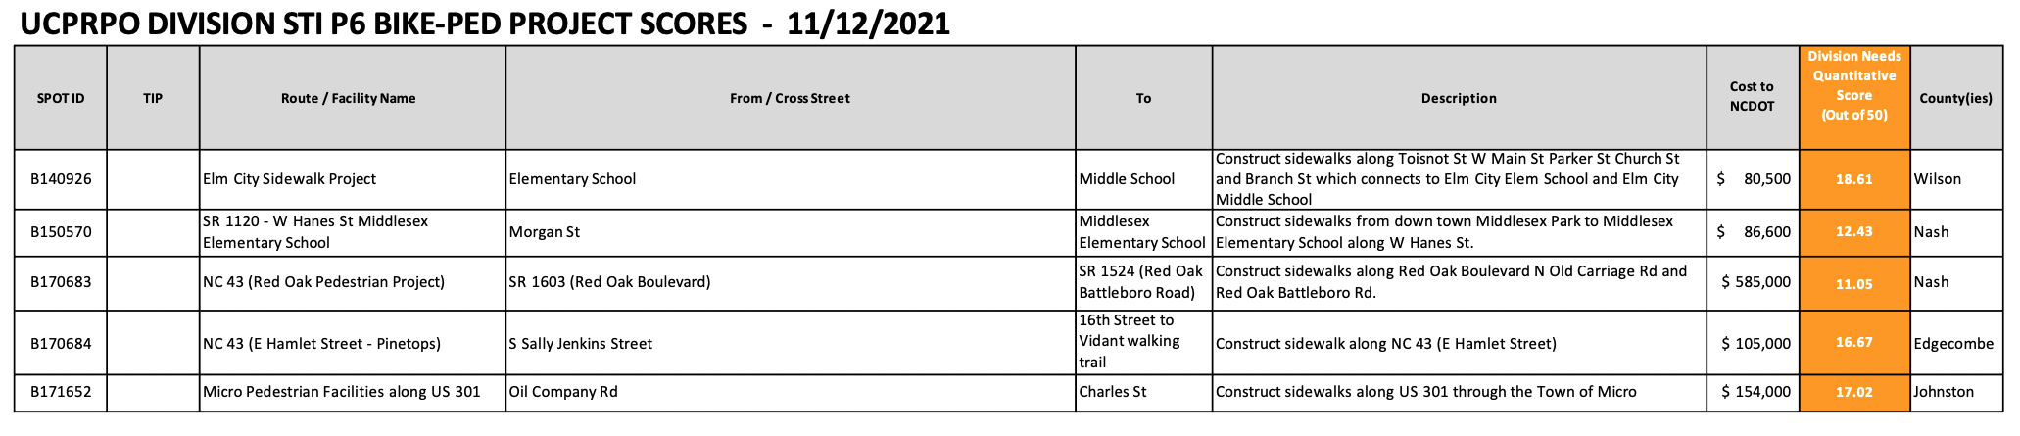
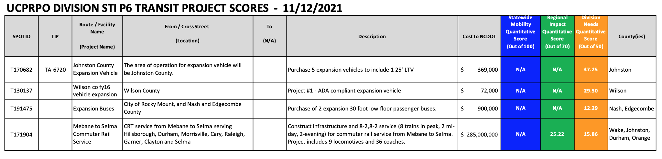
UCPRPO TCC Meeting
Edgecombe County - Johnston County – Nash County – Wilson County
January 4, 2022
7. Prioritization P6 Update – STI Project Scores Released

Slide 14
UCPRPO TCC Meeting
Edgecombe County - Johnston County – Nash County – Wilson County
January 4, 2022
7. Prioritization P6 Update – STI Project Scores Released

Slide 15
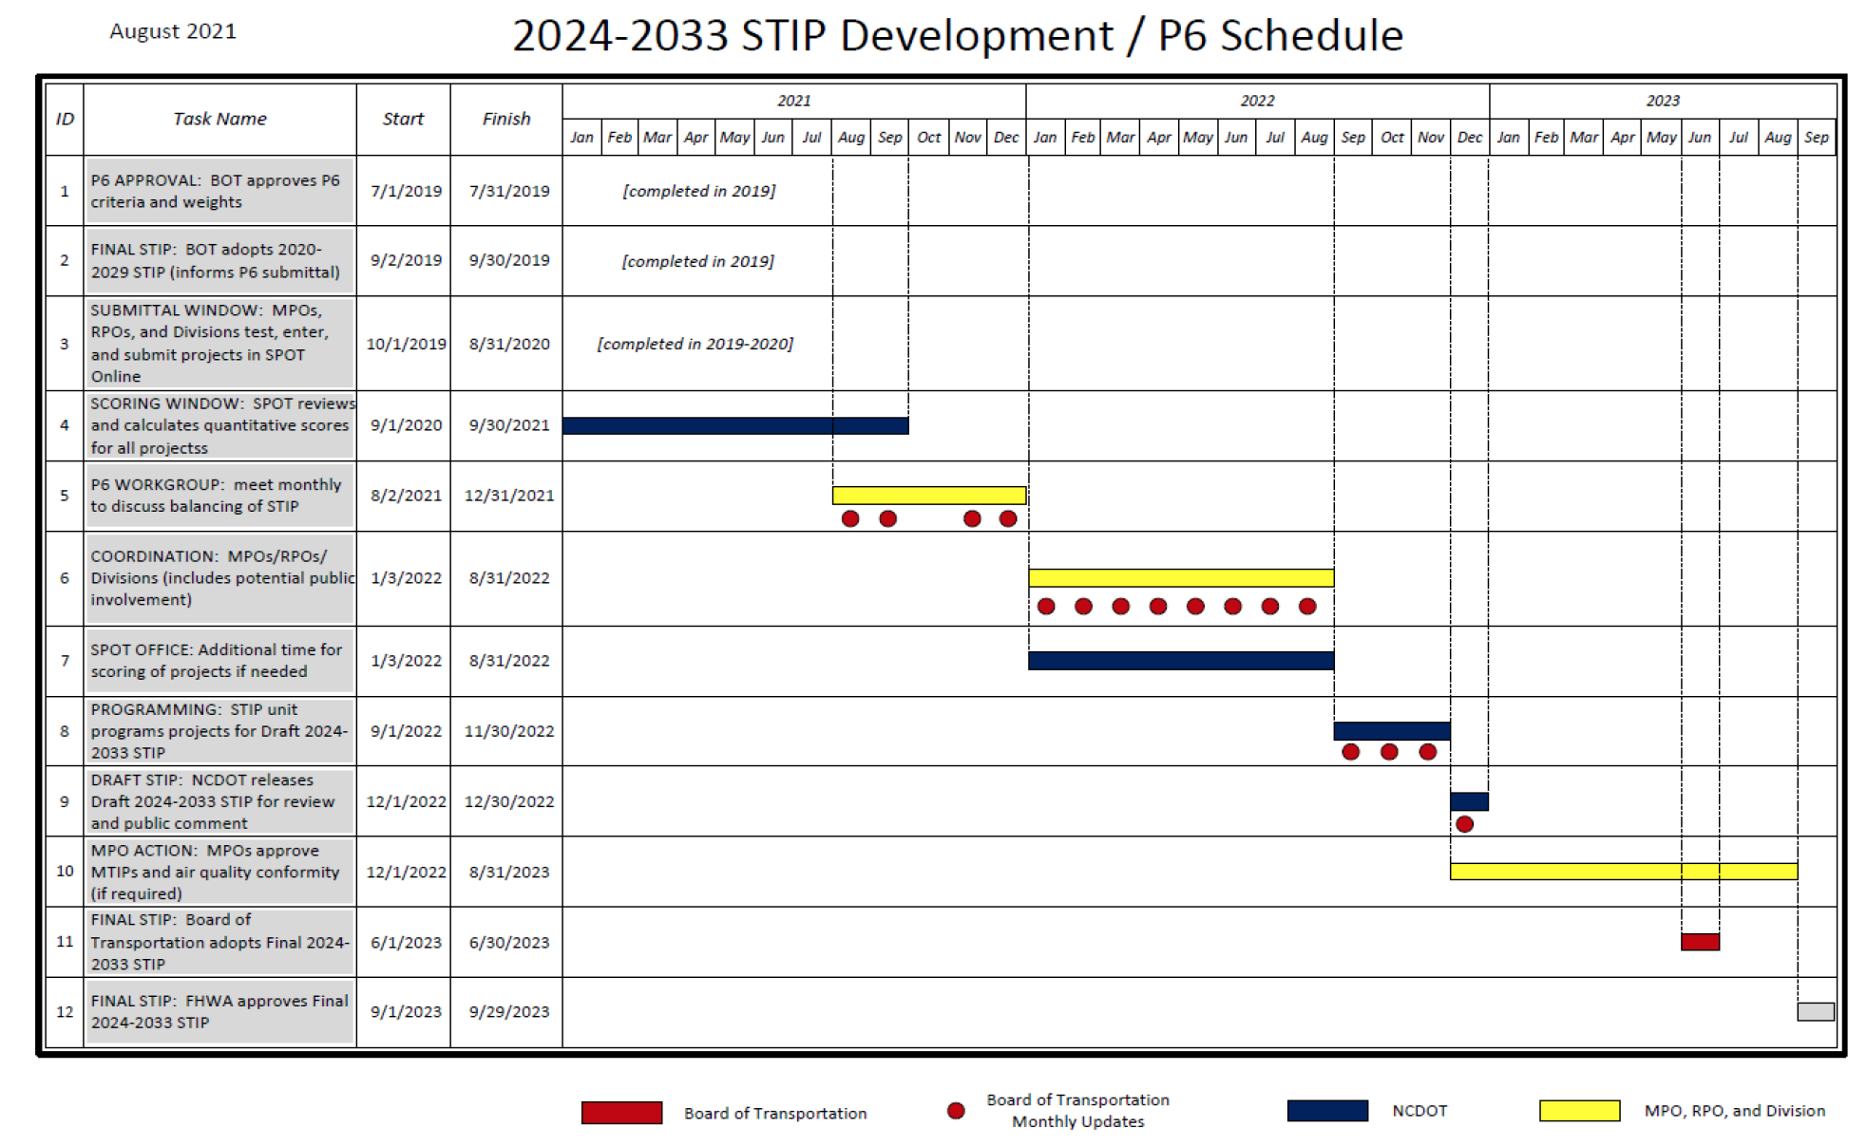
UCPRPO TCC Meeting
Edgecombe County - Johnston County – Nash County – Wilson County
January 4, 2022

Slide 16
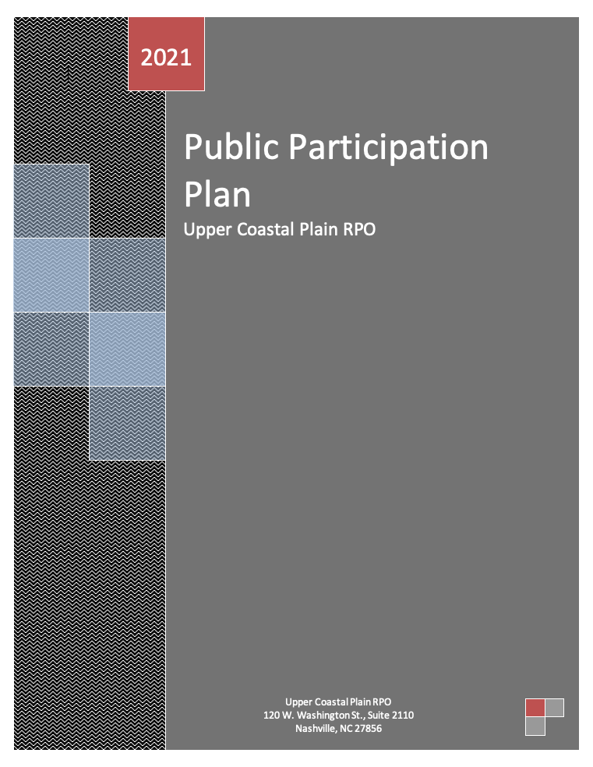
UCPRPO TCC Meeting
Edgecombe County - Johnston County – Nash County – Wilson County
January 4, 2022
8. DRAFT Public Participation Plan (PPP)
Public involvement is a very important component of the UCPRPO’s input and decision-making process and public involvement is synonymous with public participation.
The PPP provides a guidance and policy in engaging the public in the transportation planning process.
The Draft PPP was provided in the agenda packet and the TCC will be asked to approve it for recommendation to the TAC at the March TCC meeting.
Please provide any comments by February 15, 2022.

Slide 17
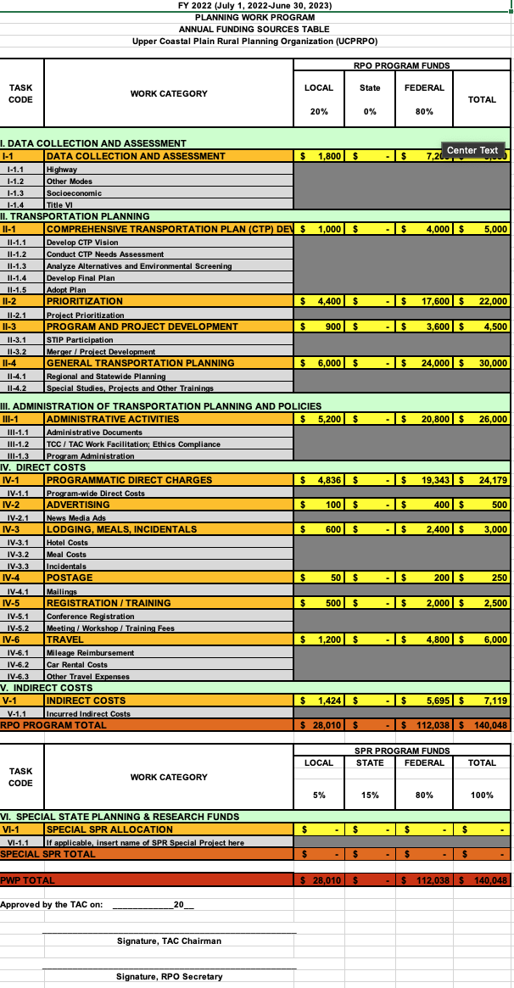
UCPRPO TCC Meeting
Edgecombe County - Johnston County – Nash County – Wilson County
January 4, 2022
9. DRAFT Planning Work Program FY2223 (PWP)
A copy of the draft FY2223 PWP was included within the TCC agenda packet.
The program requires a 20% local match that is charged to each County member.

Slide 18
UCPRPO TCC Meeting
Edgecombe County - Johnston County – Nash County – Wilson County
January 4, 2022
9. DRAFT Planning Work Program FY2223 (PWP)
The PWP is used to govern the use of funds and staff time during the upcoming FY2223 fiscal year. The PWP must be submitted to NCDOT each February for their review and approval.
The PWP document includes a table showing anticipated funding in a number of task categories and a narrative describing the anticipated work in each category.
Today we are releasing the UCPRPO DRAFT FY2223 PWP for member and public comment. After receiving comments and approval from NCDOT, the FY2223 PWP will be brought back to the TCC for consideration of recommending the PWP to the TAC at the March meeting.

Slide 19
UCPRPO TAC Meeting
Edgecombe County - Johnston County – Nash County – Wilson County
January 4, 2022
9. Draft FY2022-2023 Planning Work Program (PWP)
Transportation Planning and Admin Costs Work Category | Local Match 20% | Federal SPR Funds 80% | Total
I-1 Data Collection and Assessment | $1,800 | $7,200 | $9,000
II-1 Comprehensive Transportation Plan Development | $1,000 | $4,000 | $5,000
II-2 Prioritization and Program Development | $4,400 | $17,600 | $22,000
II-3 Project Development | $900 | $3,600 | $4,500
II-4 General Transportation Planning | $5,200 | $24,000 | $26,000
III-1 Administrative Documents and Public Involvement | $5,200 | $20,800 | $26,000
Direct and Indirect Costs Work Category | Local Match 20% | Federal SPR Funds 80% | Total
IV-1 Programmatic Direct Charges | $4,836 | $19,343 | $24,179
IV-2 Advertising | $100 | $400 | $500
IV-3 Lodging, Meals, Incidentals | $600 | $2,400 | $3,000
IV-4 Postage | $50 | $200 | $250
IV-5 Registration / Training | $500 | $2,000 | $2,500
IV-6 Travel | $1,200 | $4,800 | $6,000
V-1 Indirect Costs | $1,424 | $5,695 | $7,119

Slide 20
UCPRPO TAC Meeting
Edgecombe County - Johnston County – Nash County – Wilson County
January 4, 2022
9. Draft FY2022-2023 Planning Work Program (PWP)
Local Match – for budgeting purposes
Upper Coastal Plain RPO
DRAFT Cost Share |  | FY2022-2023
NCDOT Share | $ 112,038.40
Local Share | $ 28,009.60
Total | $ 140,048.00
 | 2020
 | Population* | % of Total | 20% Cost Share
Edgecombe | 48,900 | 0.11 | $ 3,122.44
Johnston | 215,999 | 0.49 | $ 13,792.33
Nash | 94,970 | 0.22 | $ 6,064.18
Wilson | 78,784 | 0.18 | $ 5,030.65
Total | 438,653 | 1.00 | $ 28,009.60
*North Carolina Office of State Budget and Management – 2020 Census Results

Slide 21
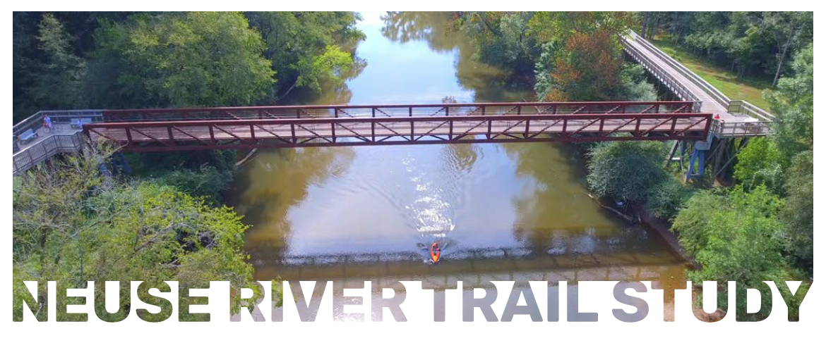
UCPRPO TCC Meeting
Edgecombe County - Johnston County – Nash County – Wilson County
January 4, 2022
10. Neuse River Trail Clayton to Smithfield Updated
The initial kick off meeting with the Core Stakeholders Group (County and municipal planners) was held December 1, 2021.
We will be reaching out for public input in the coming months.
Recently passed NC Budget includes $29.25M for development of trails designated as NC State Parks Trails, i.e. Mountains to Sea Trail and East Coast.
Nash County Commissioners passed a Resolution of support for the Triangle Trails Initiative within at their November 15, 2021 meeting which will aid in linking trails and greenways through the region.

Slide 22
UCPRPO TCC Meeting
Edgecombe County - Johnston County – Nash County – Wilson County
January 4, 2022
11. New DRAFT Complete Streets Implementation Guide
NCDOT is in the process of developing a new Complete Streets Implementation Guide. Key things to note:
Implementation Guide clarifies that NCDOT pays for complete streets enhancements when the project is in a CTP or locally adopted plan AND when a need is determined to be identified by the project manager after a new evaluation process is completed.
Clarify that maintenance agreements are needed for all separated facilities, with some exception in cases of high demand/risk.
New evaluation methodology is standardized and streamlined, and will guide project managers through a process of identifying needs, selecting the appropriate facility type, and estimating added impacts to the project.
The new approach better integrates Complete Streets evaluation into project development and will lead to more consistent inclusion of appropriate bicycle and pedestrian facilities on NCDOT projects statewide.
Tools developed for the new process will supplement site observations, project-specific data, and local/community feedback when determining need.

Slide 23
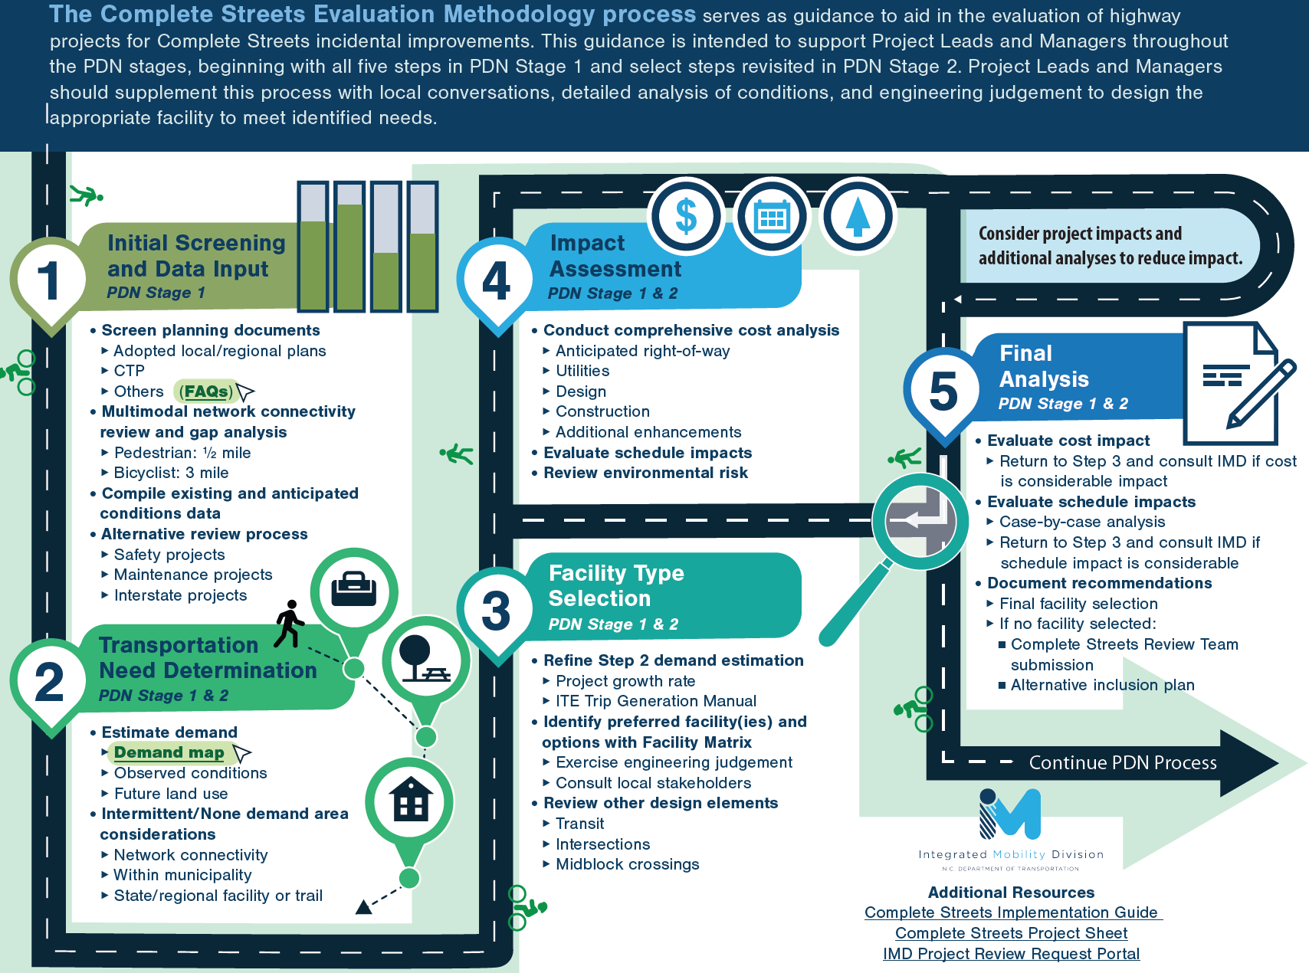
UCPRPO TCC Meeting
Edgecombe County - Johnston County – Nash County – Wilson County
January 4, 2022

Slide 24
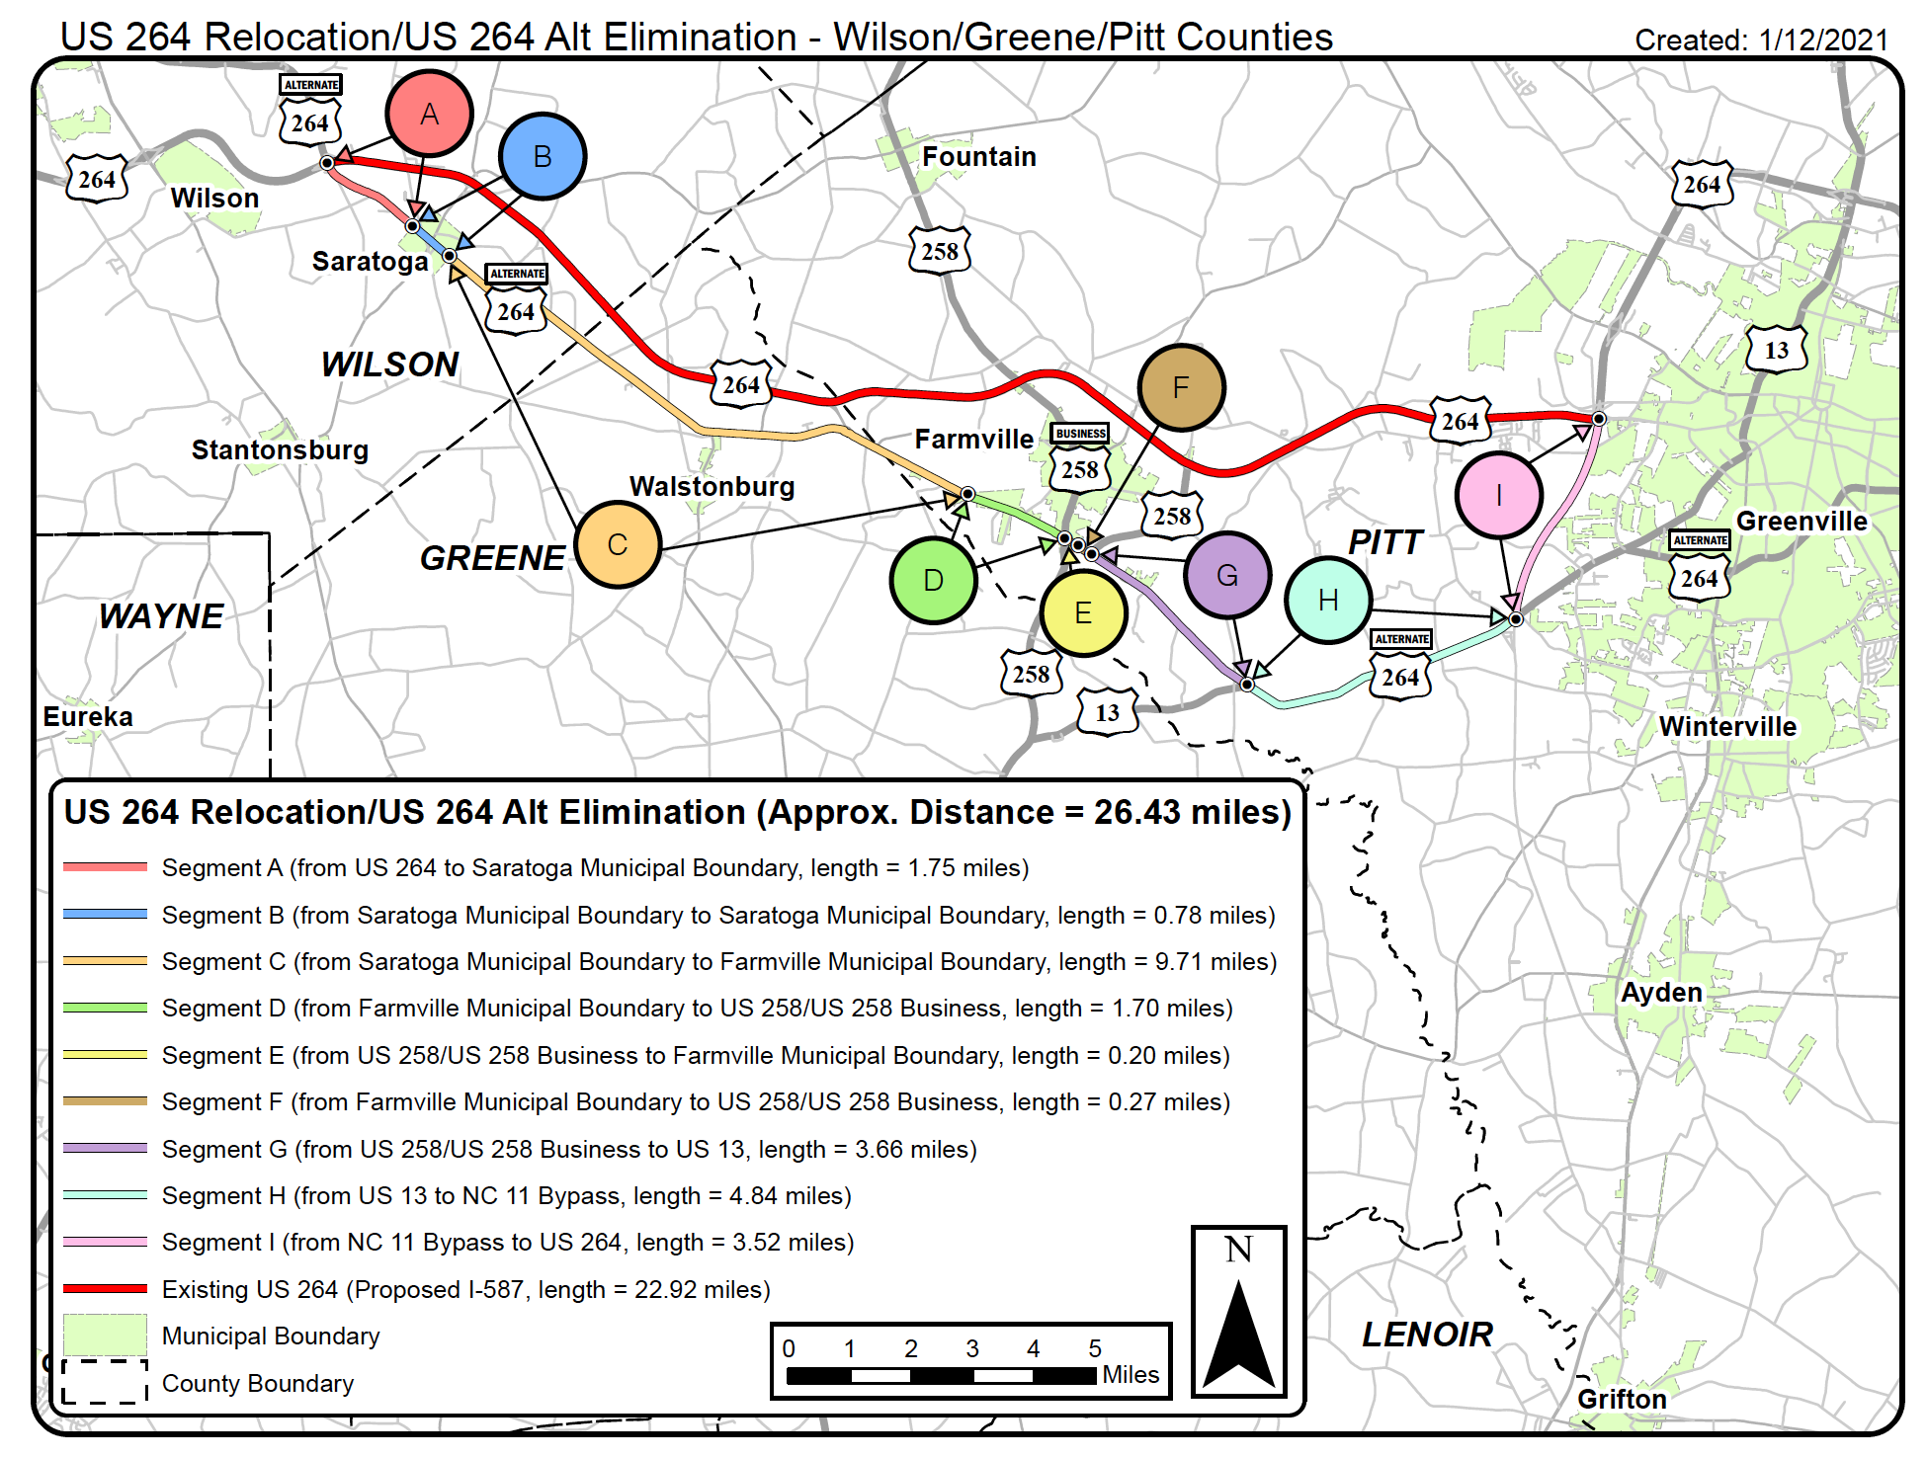
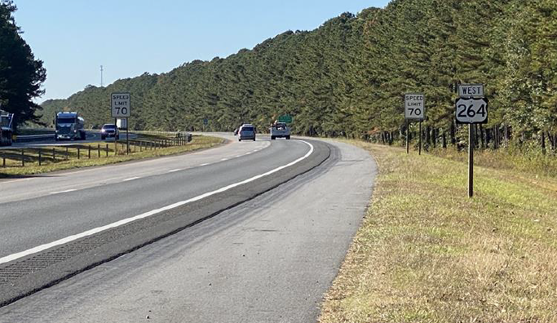
UCPRPO TCC Meeting
Edgecombe County - Johnston County – Nash County – Wilson County
January 4, 2022
12. US 264 Earns Interstate Designation – I-587
The new interstate will be I-587 and runs between I-95/I-795 in Wilson County to NC 11/US 264 interchange in Greenville, totaling 37 miles across Wilson, Greene and Pitt Counties. Before this designation, Greenville was one of the largest cities in the US not served by an interstate.

Slide 25
UCPRPO TCC Meeting
Edgecombe County - Johnston County – Nash County – Wilson County
January 4, 2022
13. US 70 Commission
The US 70 Commission met on December 9, 2021. Here are the key points in the meeting:
Division 2 and Division 4 Board of Transportation members gave a brief update
Board Member Mitchell: CCX facility is now open, US 264 giving I-587 designation, and NCDOT is reaching out to small, woman, and minority owned businesses.
Chief Engineer gave a brief update on the recently funding passed by the State and US Congress.
Divisions’ 2 and 4 gave updates on projects along US 70/I-42 corridor.
The US 70 Commission passed a resolution of support for NCDOT to fund the I-42 projects in Princeton and Kinston. Project R-5829B in Princeton is within the UCPRPO and is currently in the STIP but may be delayed due to over programming with R/W to begin in 2025. Project includes GARVEE BOND Funding.

Slide 26
UCPRPO TCC Meeting
Edgecombe County - Johnston County – Nash County – Wilson County
January 4, 2022
14. Hwy 17/64 Association
No Report. The Association has not met since our last meeting.

Slide 27
UCPRPO TCC Meeting
Edgecombe County - Johnston County – Nash County – Wilson County
January 4, 2022
15. Legislative Update
NC State Budget – Passed and signed by the Governor November 2021 - Key Points
Funding increases for SFY2022 by $161M and a funding increase for SFY2023 by $314M.
Powell Bill Funds to be increased by $12M statewide. Municipalities with 400,000 or more in population are to receive the same amount as in FY2020-2021 fiscal year. The remaining Powell Bill funds shall be allocated to municipalities with a population less than 400,000.
Employees to receive a 2.5% pay increase for FY2022 and 2.5% increase for SFY2023, additional pay bonuses from the State Fiscal Recovery Fund in the amount of $17.5M.
Eliminated 193 vacant positions that have been open for 4 years or more.
Due to decreased revenue projections STI funding decreased from previous fiscal years but for SFY2022 STI construction funding has been decreased by $104.8M. For SFY2023 STI funding has been increased by $71.5M. (not applying new Federal Infrastructure Law).

Slide 28
UCPRPO TCC Meeting
Edgecombe County - Johnston County – Nash County – Wilson County
January 4, 2022
15. Legislative Update
NC State Budget – Key Points
Highway Fund includes $69.8M proceeds from short-term vehicle leases in SFY2022 and $74.6M in SFY2023. An additional bill was passed to remove the cap of $10M.
Contingency funding increase by $50M in SFY2022 only. This is for the discretionary projects listed in the budget proposed by the House. Currently not known which projects this funding will be applied to.
Maintenance General Maintenance Reserves (GMR) increase $70.1M in SFY2022 and $110.8M in SFY2023.
Maintenance contract resurfacing increase by $50M in each fiscal year.
Roadside Environmental increase of $18M in FY22 and $19M in FY23.
Bridge program increase of $9.8M (partially offset by statutory decrease).
Bridge preservation increase of $2.2M
Build NC bonds for ~$300M planned for the Spring of 2022.

Slide 29
UCPRPO TCC Meeting
Edgecombe County - Johnston County – Nash County – Wilson County
January 4, 2022
15. Legislative Update
The Infrastructure Investment and Jobs Act (IIJA) or the Bipartisan Infrastructure Deal (BID)
Law is HUGE and complicated! Agenda packets includes detail Bipartisan Analysis of the law produced by National Association of Regional Councils (NARC) and an overview from Strategics Consulting. It allows local communities to apply for some funding and not just NCDOT.
Law includes $567.5B in spending which will go to the USDOT. Of that $274.1B is new funding.
Most of this funding ($184B) is “guaranteed appropriations” to existing programs and new programs.
Have not received official information, guidance, or details on funding to NC as of December 20, 2021.

Slide 30
UCPRPO TCC Meeting
Edgecombe County - Johnston County – Nash County – Wilson County
January 4, 2022
15. Legislative Update
The Infrastructure Investment and Jobs Act (IIJA) or the Bipartisan Infrastructure Deal (BID)
Does not solve the problems with the Highway Trust Fund – merely keeps it solvent for another 5 years when the problem will need to be solved again but includes large amount of funding.
Law expected to bring $1.7B over 5 years to NCDOT. Note the STIP is still over programmed due to low-cost estimates and increases in costs for labor and materials.
Bill provides funding for a pilot program to evaluate revenues from Vehicle Miles User Fees (VMUF).

Slide 31
UCPRPO TCC Meeting
Edgecombe County - Johnston County – Nash County – Wilson County
January 4, 2022
16. NCDOT Division 4 Update
NCDOT Division 4 Update
Jennifer Collins, P.E.
Division 4 Corridor Engineer
252-640-6436
jkcollins@ncdot.gov

Slide 32
UCPRPO TCC Meeting
Edgecombe County - Johnston County – Nash County – Wilson County
January 4, 2022
17. NCDOT Transportation Planning Division (TPD) Update
TPD Update by:
Carlos Moya-Astudillo, EI
Planning Engineer, TPD
919-707-0934
cemoya@ncdot.gov

Slide 33
UCPRPO TCC Meeting
Edgecombe County - Johnston County – Nash County – Wilson County
January 4, 2022
18. TCC Member Comments
Any additional TCC Member Comments…………

Slide 34
UCPRPO TCC Meeting
Edgecombe County - Johnston County – Nash County – Wilson County
January 4, 2022
19. Public Comment
Public Comment

Slide 35
UCPRPO TCC Meeting
Edgecombe County - Johnston County – Nash County – Wilson County
January 4, 2022
Dates for future meetings
Future TCC Meeting Dates:
March 1, 2022
May 3, 2022
July 12, 2022
September 6, 2022

Slide 36
UCPRPO TCC Meeting
Edgecombe County - Johnston County – Nash County – Wilson County
January 4, 2022
Need a motion and a second for:
ADJOURNMENT
and
Roll Call
Next meeting: March 1, 2022

